Slide 1

Safety In the Science Lab
Lab Safety: Everyone Is Responsible!
Rules and Symbols
Worley Middle School
2013-2014

Slide 2
Safety First
Science is a hands-on laboratory class.
You will be doing many laboratory activities, which require the use of hazardous chemicals and expensive lab equipment.
Safety in the science classroom is the #1 priority.
To ensure a safe science classroom, a list of rules has been developed and provided to you in your student safety contract.
These rules must be followed at all times.
A signed lab safety contract is required to participate in labs.

Slide 3
General Safety Guidelines
Be Responsible at All Times. No horseplay, practical jokes, pranks, etc.
Follow all instructions carefully.
Do not play with lab equipment until instructed to do so.
Food, drink, and gum are not allowed in the science classroom.
Lab Safety: Everyone Is Responsible!
Notes:
Verbal & written directions. If you don’t understand ask for help.
Do not do any experiments without teacher approval.

Slide 4
General Safety Guidelines
Keep the science room clean and organized.
Notify the teacher immediately of any accidents or unsafe conditions in the science classroom!
Wash your hands with soap and water after experiments.
Never enter chemical storeroom without teacher supervision.
Never work alone.
Lab Safety: Everyone Is Responsible!
Notes:
Keep aisles clear, wash equipment, put notebooks in desks, etc.

Slide 5



Safety Symbols
Eye Protection
Wear safety goggles when working with chemicals, flames, or heating devices.
If a chemical gets in your eye, flush in water for 15 minutes and notify the teacher.
Sharp Objects
When using knifes or other sharp objects always walk with the points facing down.
Cut away from fingers and body.
Electrical Safety
Do not place a cord where someone can trip over it.
Never use electricity around water.
Unplug all equipment before leaving the room.

Slide 6


Safety Symbols
Animal Safety
Only handle living organisms with teacher permission.
Always treat living organisms humanely.
Wash your hands after handling animals.
Heating Safety
Tie back hair and loose clothes when working with open flames.
Never look into a container as you are heating it.
Heated metal and glass looks cool, use tongs or gloves before handling.
Never leave a heat source unattended.

Slide 7



Safety Symbols
Chemical Safety
Read all labels twice before removing a chemical from the container.
Never touch, taste, or smell a chemical unless instructed by the teacher.
Transfer chemicals carefully!
Hand Safety
If a chemical spills on your skin, notify the teacher and rinse with water for 15 minutes.
Do not pick up broken glass.
Carry glassware carefully.
Plant Safety
Do not eat any plants in lab.
Wash your hands after handling plants.

Slide 8

Safety Equipment
Fire Blanket – On top shelf of safety shower
Fire Extinguisher – Front of Classroom
To operate the fire extinguisher remember P-A-S-S
P- Pull the Pin
A-Aim the hose at the base of the fire from 5-6 feet away.
S-Squeeze the handle.
S-Sweep the hose back and forth across the fire.
On Fire?
REMEMBER: Stop, Drop, & Roll

Slide 9
Safety Equipment
Safety Shower – Front Right Corner of Classroom
Eye Wash Station – attached to Safety Shower
First Aid Kit – On top shelf of safety shower
Biohazard Kit – On top shelf of safety shower

Slide 10
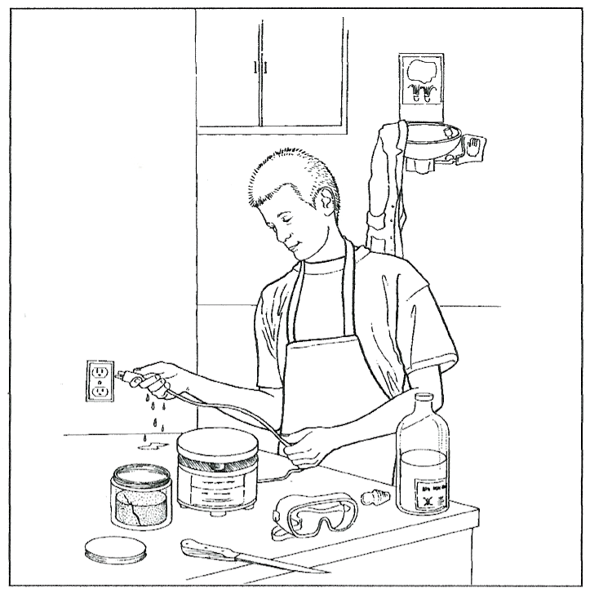
What’s Wrong With This Picture?

Slide 11
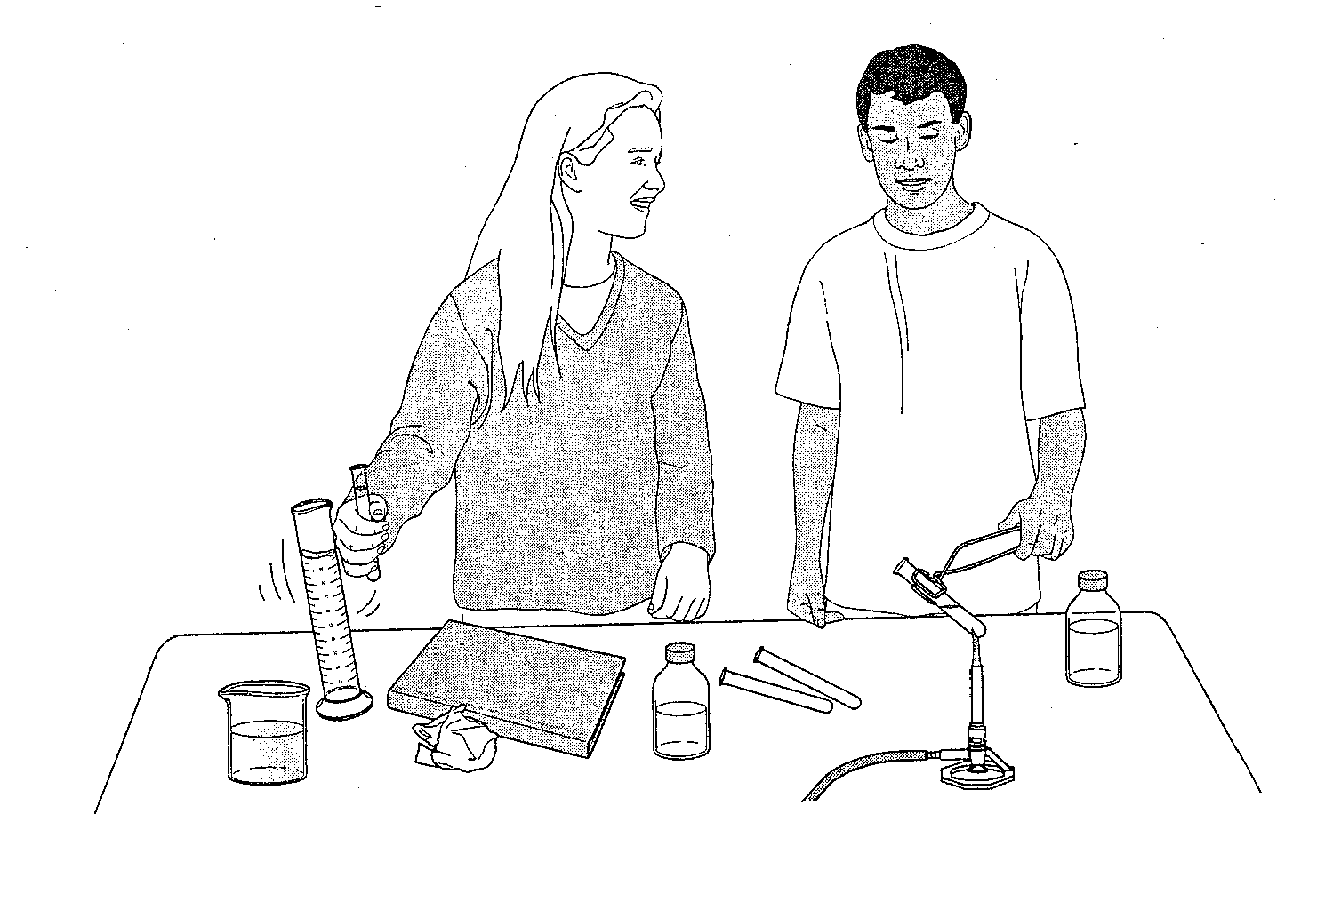
What’s Wrong With This Picture?

Slide 12
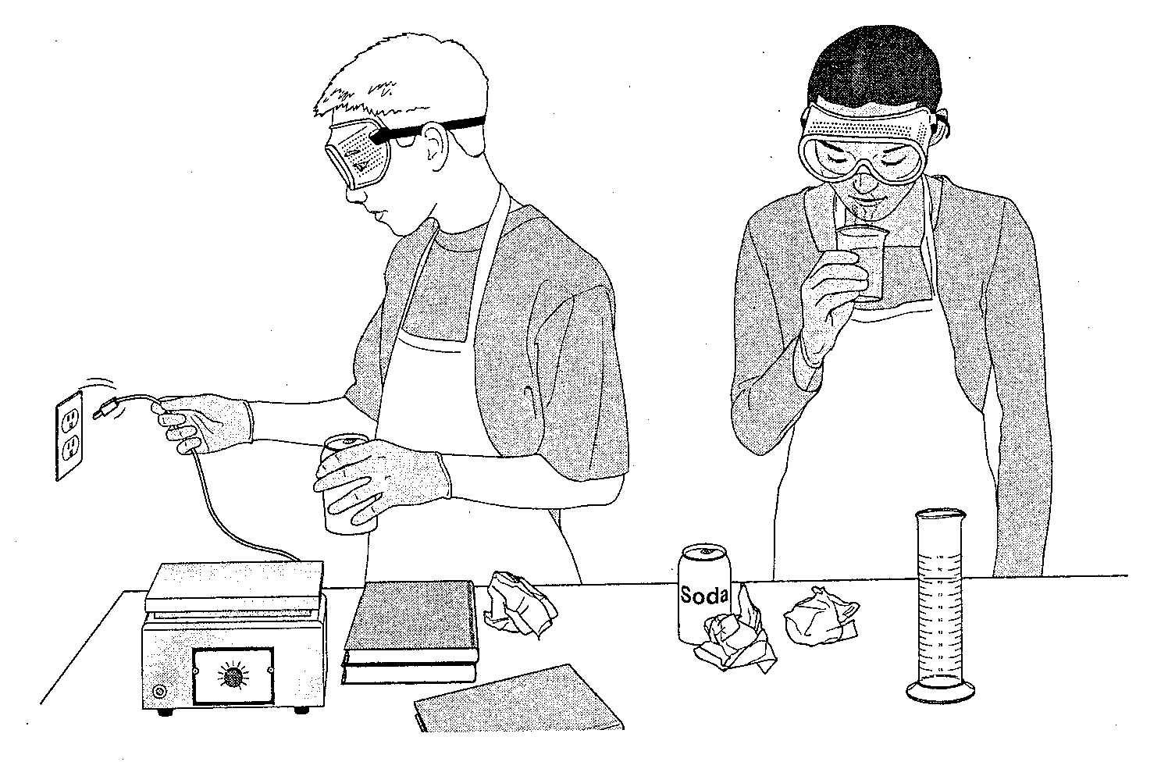
What’s Wrong With This Picture?

Slide 13
What’s Wrong With These Statements?
Avon says that his teacher is solely responsible for preventing laboratory accidents.
Henry started the lab activity before reading it through completely.
Van decided to do a lab activity that he read about in a library book before the teacher came into the classroom.
Stephanie says that the safety goggles mess up her hair and give her raccoon eyes. She refuses to wear them.
Barbie and Ken accidentally break a beaker full of some chemical. Instead of risking getting in trouble they quickly clean up the mess with paper towel and throw it in the garbage.

Slide 14
What To Do In An Emergency
If there is a fire or fire alarm
  Quietly get up and push in your chair.
  Walk toward the outside classroom door.
  Walk across the drive to the field.
  Quickly line up.
  Remain in line until the drill is over.
  Remain silent throughout the entire alarm so that all people can hear important directions.
Lab Safety: Everyone Is Responsible!

Slide 15

Any Questions?
REMEMBER:
Carefully read through the entire safety contract and sign.
Have your parents read and sign your safety contract.
Study for the safety check later this week!

