Slide 1
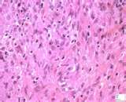
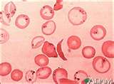
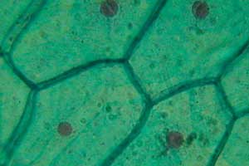
CELL THEORY NOTES

Slide 2
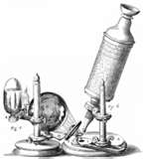
History
Anton Van Leeuwenhoek
The microscope was invented by Anton Van Leeuwenhoek, a Dutch biologist in the early 1600’s. Leeuwenhoek’s invention allowed him to see tiny living organisms in droplets of water.

Slide 3
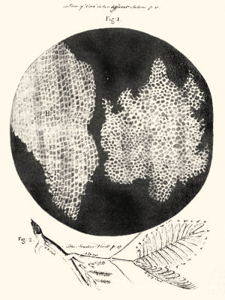
History
Robert Hook
Became interested in Van Leeuwenhoek’s microscope and used one to look at pieces of cork.
He could see that it was composed of thousands of tiny chambers. He called these chambers “cells” since they reminded him of the small rooms called cells in a monastery.
His discovery was significant since it opened up the study of cells.

Slide 4
Over the next 300 years…
Robert Brown – observed that many cells had a dark structure near the center of the cell, which we now call the nucleus (1833).
Matthias Schleiden – stated that all plants are made of cells. (1838)
Theodor Schwann – discovered that all animals are made of cells too (1839).
Rudolf Virchow – stated that all cells arise from the division of preexisting cells (1855).
Janet Plowe – demonstrated that the cell membrane is a physical structure, not just an interface between two liquids (1931).

Slide 5
The cell theory states:
1. All living things are composed of one or more cells.
2. Cells are the basic units of structure and function in living things.
3. All cells come from preexisting cells.

Slide 6
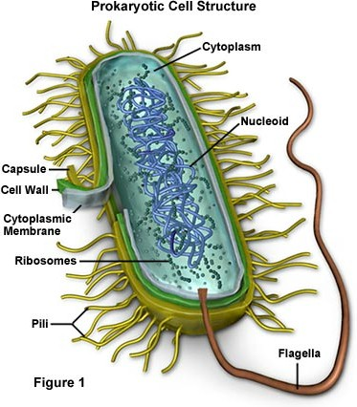
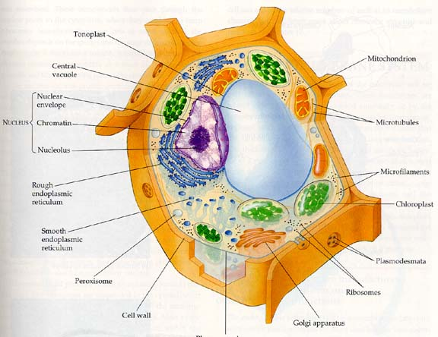
2 Basic Cell Types
Prokaryotes
Eukaryotes

Slide 7
Prokaryotes-
Cells that DO NOT contain membrane-bound structures
Eukaryotes-
Cells that DO contain membrane-bound structures
Membrane-bound structures inside eukaryotic cells are called ORGANELLES. Each organelle has a specific function.

