Slide 1
Ms. Wilson’s Science Class
8th Grade Science
Room: C-311

Slide 2
Remind 101 Information:
To: 81010
Text: @mswilson8

Slide 3
Daily Quiz: Monday-August 24, 2015
Today’s Objective: We will interpret our syllabus.
What is your favorite subject in school?
What is your favorite hobby?
Closing Objective: Identify and list 2 things that I learned about Ms. Wilson.

Slide 4
Daily Quiz: Tuesday -August 25, 2015
Today’s Objective: We will interpret our syllabus and discuss Cornell notes.
Identify two subjects that we will cover in the 1st six weeks. (Refer to syllabus)
Identify the weight percentages for the following: (Refer to syllabus)
-Tests/Projects
-Homework/Daily Work
-Quizzes
Closing Objective: Record the two things you need to turn in by Friday.

Slide 5
Daily Quiz: Wednesday -August 26, 2015
Today’s Objective: We will identify proper safety procedures.
What is something that is unsafe do to in a science classroom?
What’s due Friday?
Closing Objective: Record the two safety procedures you learned today.

Slide 6
Daily Quiz: Thursday -August 27, 2015
Today’s Objective: We will identify proper safety procedures.
Where is the eye wash station?
If you are on fire, what should you do?
Closing Objective: Which rule is your poster about?

Slide 7
Daily Quiz: Friday -August 28, 2015
Today’s Objective: We will evaluate our knowledge of proper safety procedures.
When do you wear goggles?
What is important when dealing with heating safety?
Closing Objective: How can you tell if glass is hot by looking at it and how should you handle it?
TURN IN DAILY QUIZ

Slide 8
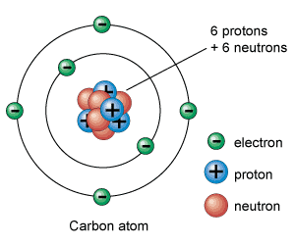
Daily Quiz: Monday -August 31, 2015
Today’s Objective: describe the structure of atoms.
Turn in your cartoon. (Put in your class tray at the back of the classroom)
What is the center of an atom called?
a. nucleus
b. element
c. electron
Closing Objective: What do atoms make up?

Slide 9
Daily Quiz: Tuesday – September 1, 2015
Today’s Objective: I will describe the structure of atoms.
1. The three smaller components that make up atoms are –
2. Which of the following lists the two particles found together inside the nucleus of an atom?
Closing Objective: Correct and explain the right answer to your warm up questions.
A | neutrons, protons and ions.
B | neutrons, electrons and protons.
C | protons, ions and electrons.
D | electrons, neutrons and ions
A | Photons and ions
B | Neutrons and electrons
C | Protons and neutrons
D | Electrons and protons

Slide 10
Daily Quiz: Wednesday – September 2, 2015
Today’s Objective: I will model the structure of atoms.
A neutral atom has an equal number of positive and negative charges.
If a neutral fluorine atom has 9 protons and 10 neutrons,
how many electrons will it have?
2. If an atom has six positively charged subatomic particles, which of the following must it also have in order to become a neutral atom?
Closing Objective: Correct and explain the right answer to your warm up questions.
A | 10
B | 9
C | 8
D | 7
A | Twelve protons
B | Six neutrons
C | Three electrons
D | Six electrons

Slide 11
Daily Quiz: Thursday – September 3, 2015
Today’s Objective: I will model the structure of atoms.
Write question and answer!!
What happens when you change the number of protons in an atom?
What are the charges for the subatomic particles listed below?
Protons-
Neutrons-
Electrons-
Closing Objective: Write the symbols that represent each subatomic particle, and label them.

Slide 12
Daily Quiz: Friday – September 4, 2015
Today’s Objective: I will model and describe the structure of atoms.
Write question and answer!!
What is the mass of Fluorine?
What is the amount of each subatomic particle in Fluorine?
Protons-
Neutrons-
Electrons-
Closing Objective: What are you afraid of? Example: McKenna Griffin is scared of butterflies.

Slide 13
Daily Quiz: Tuesday – September 8, 2015
Today’s Objective: I will identify that protons determine an element’s identity and valence electrons determine its chemical properties.
Write question and answer!!
How many neutrons are in a neutral sodium atom?
11
12
22
23
2. How many electrons are in a neutral atom of carbon with 8 neutrons?
2
6
8
14
Closing Objective: Correct and explain.

Slide 14
Daily Quiz: Wednesday – September 9, 2015
Today’s Objective: I will identify that protons determine an element’s identity and valence electrons determine its chemical properties.
Write question and answer!!
An element can be identified by its unique number of –
Ions
Electrons⁻
Protons⁺
neutrons⁰
2. The reactivity of an atom is determined by –
its number of valence electrons.
the radius of the atom’s nucleus.
its atomic mass of the element.
the orbital path of its electrons.
Closing Objective: Correct and explain.

Slide 15
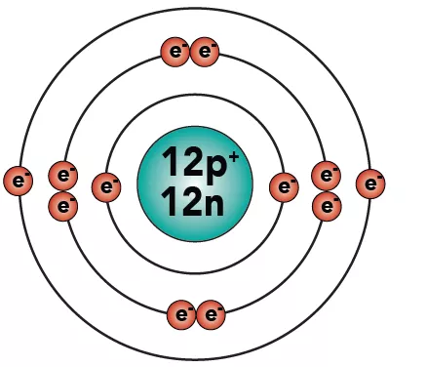
Daily Quiz: Monday – September 14, 2015 Today’s Objective: I will identify that protons determine an element’s identity and valence electrons determine its chemical properties.
Write question and answer!!
How do you find the number of valence electrons?
Why do we need to know how many valence electrons an atom has? What do valence electrons indicate?
Closing Objective: What does “APE MAN” stand for and how is it helpful?

Slide 16
Daily Quiz: Tuesday – September 15, 2015 Today’s Objective: I will identify that protons determine an element’s identity and valence electrons determine its chemical properties.
Write question and answer!!
What do the group numbers on the periodic table tell us?
Draw the Bohr Model for Cl using “APE MAN” .
Closing Objective: What is something you want clarified before your test? Where can you find the review answer key?

Slide 17
Daily Quiz: Wednesday – September 16, 2015 Today’s Objective: Evaluate our knowledge of atomic structures.
Write question and answer!!
What three parts must you draw on every Bohr Model?
What can you use to help you draw a Bohr Model?
Closing Objective: Why do you think gold has the atomic symbol “Au” ?

Slide 18
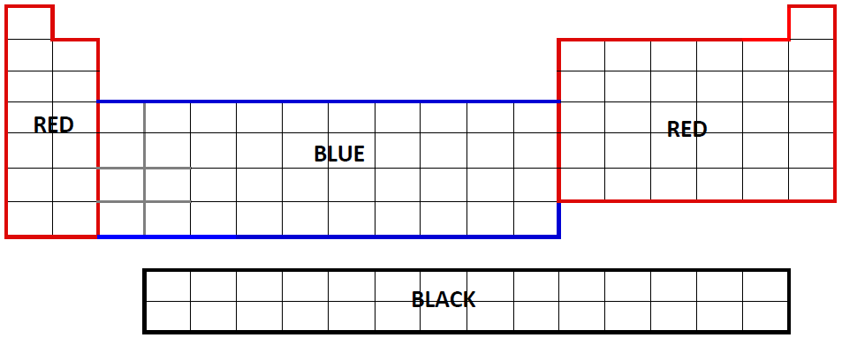
Daily Quiz: Friday – September 18, 2015 Today’s Objective: Interpret the arrangement of the Periodic Table. Write that you started Part two of your student Journal in the question blanks of your daily quiz.
On your Periodic Table from yesterday:
Use a red marker to outline Groups 1A and 2A
Use a red marker to outline Groups 3A to 8A.
Use a blue marker to outline Groups 3B to 12B.
Use a black marker to outline the Lanthanide and Actinide series, the two rows that appear separately at the bottom.
Closing Objective: Why do you think gold has the atomic symbol “Au” ?

Slide 19
Daily Quiz: Monday – September 21, 2015 Today’s Objective: Interpret the arrangement of the Periodic Table. Write questions and answers.
Grab a new daily quiz and a vocabulary sheet off my front table.
1. What do the periods on
the Periodic Table tell us?
2. What do the groups on
the Periodic Table tell us?
Closing Objective: What are some of the Group 8 properties?

Slide 20
Daily Quiz: Tuesday – September 22, 2015 Today’s Objective: Interpret the arrangement of the Periodic Table. Write questions and answers.
Grab a new daily quiz and a vocabulary sheet off my front table.
1. What subatomic particle determines an element?
2. What are the properties of Group 1A?
Closing Objective: What are some of the Group 7 properties?

Slide 21
Daily Quiz: Thursday – September 24, 2015 Today’s Objective: Interpret the arrangement of the Periodic Table. Write questions and answers.
Grab a new daily quiz and a vocabulary sheet off my front table.
1. What are the differences between a chemical property and a physical property?
2. Identify a chemical property and a physical
Property for group 2A.
Closing Objective: When is your next test?

Slide 22
Daily Quiz: Wednesday – September 30, 2015 Today’s Objective: Interpret the arrangement of the Periodic Table. Write questions and answers.
Grab a correction handout off of the tiny desk in the front of the room.

Slide 23
Daily Quiz: Monday – October 5, 2015 Today’s Objective: Recognize that chemical formulas are used to identify substances and determine the # of atoms of each element in chemical formulas containing subscripts.. Write questions and answers.
1. What do the subscripts in a chemical formula tell us?
2. What do we call the large number in front of a chemical formula?
Closing Objective:
Balance the chemical equation: 4H2 + 2O2 ---> _____H2O

Slide 24
Daily Quiz: Tuesday – October 6, 2015 Today’s Objective: Recognize that chemical formulas are used to identify substances and determine the # of atoms of each element in chemical formulas containing subscripts. Write questions and answers.
Is this chemical equation balanced? 4H2 + 2O2 ---> 4H2O
What tool do we use to determine if a chemical
equation is balanced? What does each letter
represent?
Closing Objective:
Balance the chemical equation:
6CO2 + 6H2O ---> C6H12O6 + __O2

Slide 25
Daily Quiz: Wednesday – October 7, 2015 Today’s Objective: Evaluate our knowledge over the 1st Six weeks by taking a CBA.
Write CBA for Wednesday and fill in (MONDAY and TUESDAY’S Closing Questions)
Monday’s Closing Objective: Balance the chemical equation: 4H2 + 2O2 ---> _____H2O
Tuesday’s Closing Objective:
Balance the chemical equation:
6CO2 + 6H2O ---> C6H12O6 + __O2

Slide 26
Daily Quiz: Thursday – October 8, 2015 Today’s Objective: Recognize that chemical formulas are used to identify substances and determine the # of atoms of each element in chemical formulas containing subscripts. Write questions and answers.
Is this chemical equation balanced?
Is this chemical equation balanced?
Closing Objective:
Who is your favorite sports team?

Slide 27
Daily Quiz: Monday – October 12, 2015 Today’s Objective: Recognize that chemical formulas are used to identify substances and determine the # of atoms of each element in chemical formulas containing subscripts. Write questions and answers.
Turn in last weeks Daily Quiz.
What is the correct way to write the formula for this compound?
Closing Objective:
Do you have questions about what we are learning?

Slide 28
Daily Quiz: Wednesday – October 14, 2015 Today’s Objective: Recognize that chemical formulas are used to identify substances and determine the # of atoms of each element in chemical formulas containing subscripts. Write questions and answers.
Copy the following:
-IF ANYONE TALKS TODAY WITHOUT THE PERMISSION,
THEY WILL BE WRITTEN UP.
-IF COACH WILSON SEES ANY DEVICES OUT WITHOUT
PERMISSION, THEY WILL BE TAKEN TO THE OFFICE.
GET OUT A BLANK PIECE OF NOTEBOOK PAPER.
Closing Objective:
Write down the “I will” statements.

Slide 29
Daily Quiz: Thursday – October 14, 2015 Today’s Objective: investigate evidence of chemical reactions. Write questions and answers.
Pass back graded papers!
Go over how to do CBA corrections.
Share data from yesterday’s lab.
(I will tell you how I want this done!)
Closing Objective:
What did you observe with your lab?
What evidence of a chemical reaction did you see?

Slide 30
Daily Quiz: Friday – October 16, 2015 Today’s Objective: investigate evidence of chemical reactions. Write questions and answers.
1. What are the four indications of
a chemical reaction?
2. What is oxygen’s coefficient in
this chemical formula?
6H2O2
Closing Objective:
What is the difference between a subscript and a coefficient?

Slide 31
Daily Quiz: Monday – October 19, 2015 Today’s Objective: investigate evidence of chemical reactions. Write questions and answers.
No Daily quiz this week. Grab a Review from my desk!

Slide 32
Daily Quiz: Tuesday – October 20, 2015 Today’s Objective: investigate evidence of chemical reactions. Write questions and answers.
No Daily quiz this week. Grab a Review from my desk!

Slide 33
Daily Quiz: Wednesday – October 21, 2015 Today’s Objective: evaluate my knowledge of chemical reactions. Write questions and answers.
You have 5 minutes to study your review! You also have to turn in your review today.

Slide 34
Daily Quiz: Tuesday – October 27, 2015 Today’s Objective: We will demonstrate and calculate how unbalanced forces change the speed/direction of an object’s motion. Write questions and answers.
1. Write down what you already know about motion,
forces, speed of an object’s motion.
2. Write down what you want to know
about motion, forces, speed of an object’s
motion.
Closing Objective:
What questions do you have about motion, forces, speed of an object’s motion?

Slide 35
Daily Quiz: Wednesday – October 28, 2015 Today’s Objective: We will demonstrate and calculate how unbalanced forces change the speed/direction of an object’s motion. Write questions and answers.
1. Write down a question you have about motion,
forces, speed of an object’s motion. (This is independent)
2. Collaborate with your table and come up
with one question for the KWQL chart. (You
must write it as number 2 on your daily quiz
as well.)
Closing Objective:
What is the difference between an independent and dependent variable?

Slide 36
Daily Quiz: Monday – October 29, 2015 Today’s Objective: We will demonstrate and calculate how unbalanced forces change the speed/direction of an object’s motion. Write questions and answers.
Get out your student journal!
Write down physics investigation as your daily quiz.
Your CLOSING OBJECTIVE is posted on the small paper on the board. You will need to walk up and look at it.

Slide 37
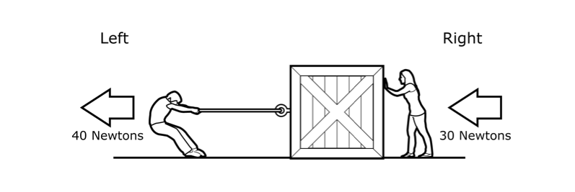
Daily Quiz: Friday – October 30, 2015 Today’s Objective: We will demonstrate and calculate how unbalanced forces change the speed/direction of an object’s motion. Write questions and answers.
1. Two students apply force to a box at rest on the floor. What is the total amount of force in Newtons acting on the box and in which direction?
2. A dog walks a distance of 100 ft in 20 s of time.
What is the dog’s speed in feet per second?
Closing Objective:
Which of the following examples best represents an object with balanced forces acting upon it?
40N
30N
A | A boat moving through the water.
B | A book sitting on a high shelf.
C | A wagon rolling down a steep hill.
D | A baseball thrown into the air.

Slide 38
Daily Quiz: Monday – November 2, 2015 Today’s Objective: We will differentiate between speed, velocity, and acceleration. Write questions and answers.
1.Speed and velocity are similar in that they both convey the -
2. Which of these is an example of a description
of speed?
A | direction in which an object moves.
B | distance and time an object moves.
C | acceleration or deceleration of a moving object.
Closing Objective:
Which of the following best describes an object that is accelerating?
A | A basketball sits motionless on the gymnasium floor.
B | A hockey puck slows down as it hits the net.
C | A soccer ball travels at 3 m/s.
D | A bird travels 100 km to the northeast.
A | An apple fell from the tree and then rolled 1 m north.
B | The average Olympic sprinter runs 8 m/s.
C | A train traveled east at 200 mph from Albuquerque to Dallas.

Slide 39
Daily Quiz: Monday – November 16, 2015 Today’s Objective: We will differentiate between speed, velocity, and acceleration. Write questions and answers.
Define Speed
Define Velocity
Define Acceleration

Slide 40
Daily Quiz: Tuesday – November 17, 2015 Today’s Objective: We will differentiate between speed, velocity, and acceleration. Write questions and answers.
Write two things you have learned about either forces, speed, acceleration, or velocity.

Slide 41
Daily Quiz: Wednesday – November 18, 2015 Today’s Objective: We will differentiate between speed, velocity, and acceleration. Write questions and answers.
What are the 4 indicators of a chemical reaction taking place?
What is a coefficient and a subscript?

Slide 42
Daily Quiz: Monday – November 30, 2015 Today’s Objective: We will investigate and describe applications of Newton’s law of inertia, law of force and acceleration, and law of action-reaction such as in vehicle restraints, sports activities, amusement park rides, Earth’s tectonic activities, and rocket launches.
1. Newton’s first law of motion, applied to a book sitting on a table, would explain that the book will not move until which of the following conditions is met?
2. According to Newton’s Third Law, if someone jumps off a skateboard, the skateboard will roll backwards because -
A | the pull of gravity on the person is the same as on the skateboard, regardless of size.
B | the air resistance on the person is great and the friction on the skateboard is small.
C | for the force that sent the person forward, there is an equal force pushing back on the skateboard.
A | Gravity on the book can be reduced to zero
B | Unbalanced forces act on the book
C | Balanced forces act on the book
Closing Objective:
State Newton’s Law of Inertia.

Slide 43
Daily Quiz: Thursday – December 3, 2015 Today’s Objective: We will investigate and describe applications of Newton’s law of inertia, law of force and acceleration, and law of action-reaction such as in vehicle restraints, sports activities, amusement park rides, Earth’s tectonic activities, and rocket launches.
1. Write that you are completing the physics worksheet
from yesterday. You have 20 minutes to finish all of the
questions (1-16) and ask about any problems you
might still have.
2. If you have a question about the worksheet,
raise your hand.
Closing Objective:
What is the formula for the following:
Work=?
Density=?

Slide 44
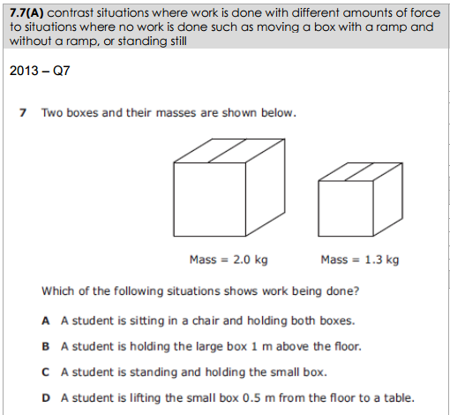
Daily Quiz: Monday – December 7, 2015 Today’s Objective: We will investigate and describe applications of Newton’s law of inertia, law of force and acceleration, and law of action-reaction such as in vehicle restraints, sports activities, amusement park rides, Earth’s tectonic activities, and rocket launches.
1.
2. Explain how writing the formulas in a triangle is helpful.
Closing Objective:
What are the different types of energy transformations?

Slide 45
Daily Quiz: Tuesday – December 8, 2015 Today’s Objective: We will investigate and describe applications of Newton’s law of inertia, law of force and acceleration, and law of action-reaction such as in vehicle restraints, sports activities, amusement park rides, Earth’s tectonic activities, and rocket launches.
What is the acronym for remembering the energy transformations?
What are Newton’s three laws?
Closing Objective:
When is your test?

Slide 46
Daily Quiz: Wednesday – December 9, 2015 Today’s Objective: We will investigate and describe applications of Newton’s law of inertia, law of force and acceleration, and law of action-reaction such as in vehicle restraints, sports activities, amusement park rides, Earth’s tectonic activities, and rocket launches.
Study for your test! Get out your IPads.
Reviews are due today!
Closing Objective:
No closing question today.

Slide 47
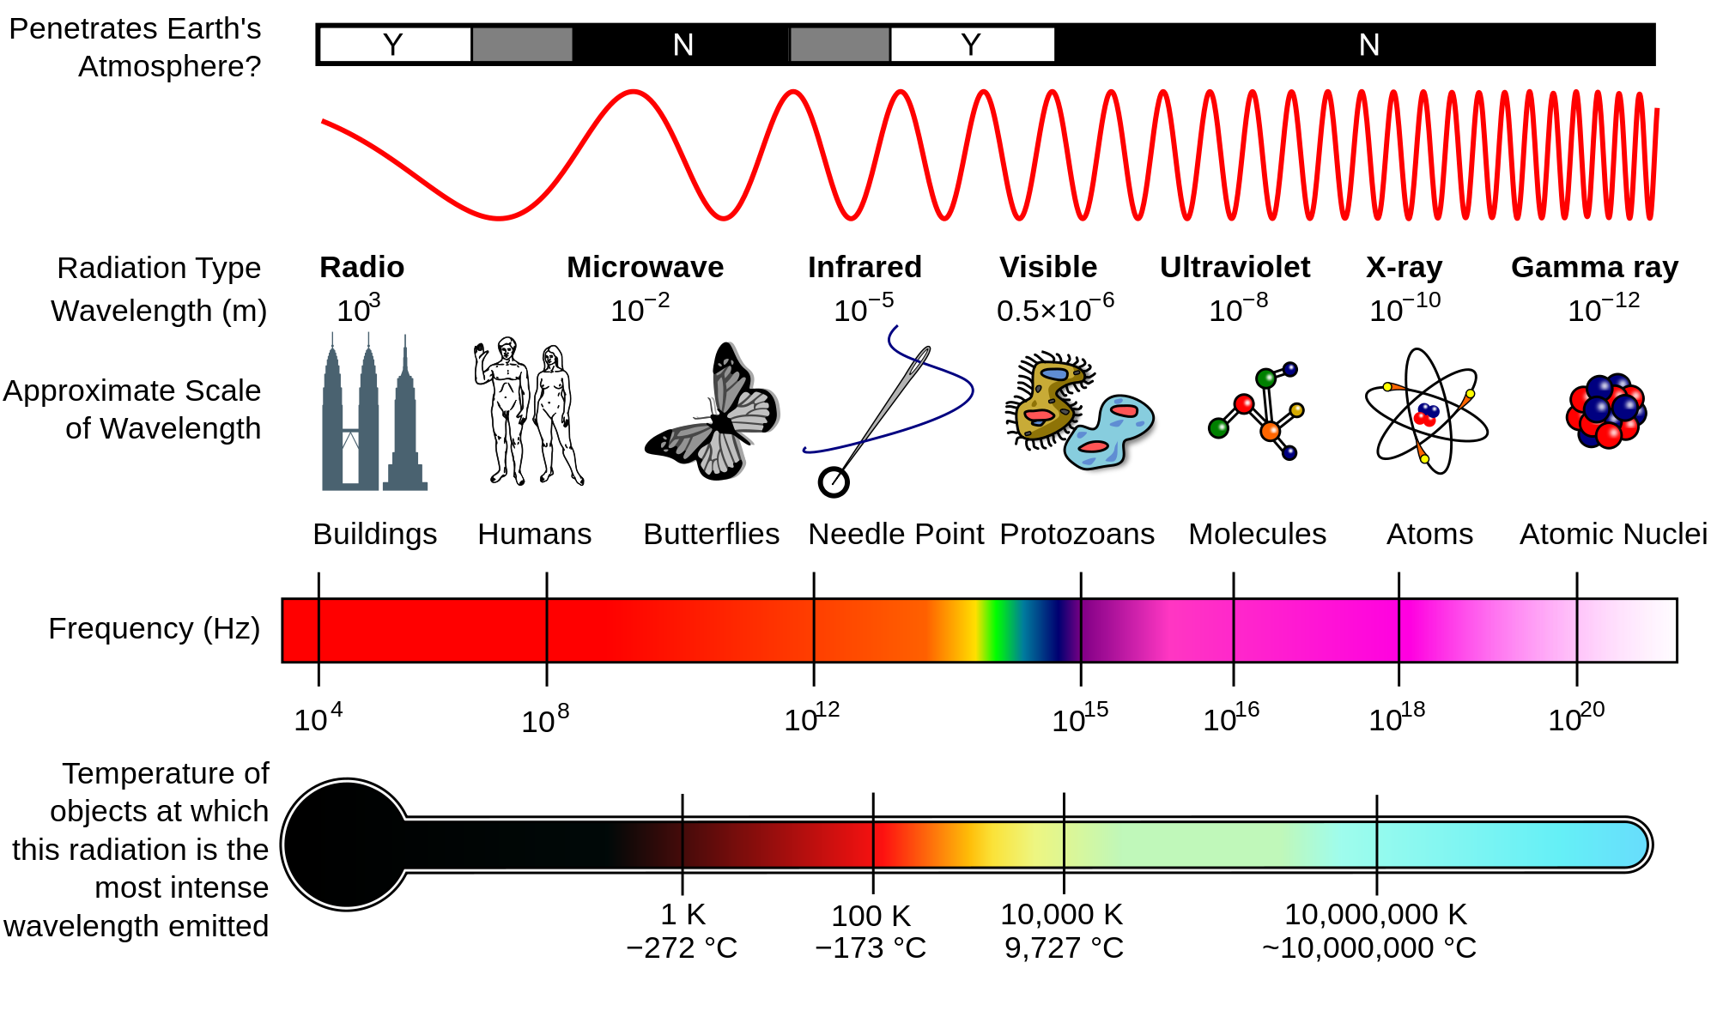
Daily Quiz: Monday – December 14, 2015 Today’s Objective: We will explore how different wavelengths of the electromagnetic spectrum such as light and radio waves are used to gain info about distances and properties of components of the universe.
Get out your homework from Friday.
Clear off your desk except for your homework, scissors (if you have them) and a writing utensil.
Closing Objective:
No closing question today.

Slide 48
Daily Quiz: Tuesday – January 5, 2016 Today’s Objective: We will describe components of the universe, including stars nebulae, and galaxies, and use models such as the Hertzsprung-Russell diagram for classification.
Describe your favorite part from Christmas break.
List the following:
-1 thing you know about stars
-1 thing you want to know about stars
-1 question you have about stars
Closing Objective:
What is the first stage in the life cycle of a star?

Slide 49
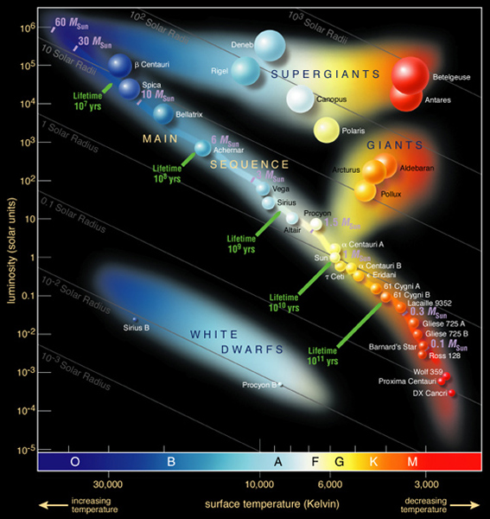
Daily Quiz: Wednesday – January 6, 2016 Today’s Objective: We will describe components of the universe, including stars nebulae, and galaxies, and use models such as the Hertzsprung-Russell diagram for classification.
Finish Pt. 2 of your Student Journal.
Make sure you did yesterday’s closing objective:
”What is the first stage in the life cycle of a star?”
If you did not get a Vocabulary list yesterday, make sure you get it today. You have a Vocab Test Friday!!
Closing Objective:
What is the H-R diagram?

Slide 50
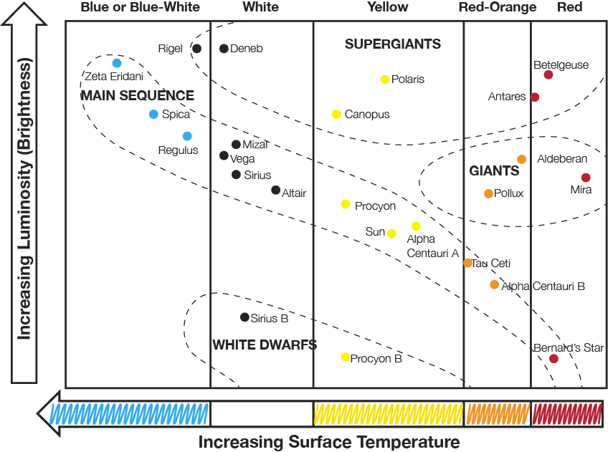
Daily Quiz: Thursday – January 7, 2016 Today’s Objective: We will describe components of the universe, including stars nebulae, and galaxies, and use models such as the Hertzsprung-Russell diagram for classification.
Which star is brighter? Polaris or Sirius B
If a star is in the blue section is it cooler or hotter than a star in the red section?
Closing Objective:
Which galaxy is shaped like a football/egg?

Slide 51
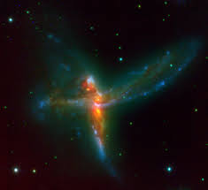
Daily Quiz: Friday – January 8, 2016 Today’s Objective: We will describe components of the universe, including stars nebulae, and galaxies, and use models such as the Hertzsprung-Russell diagram for classification.
What is the name of our galaxy and what type of galaxy is it?
Describe the other two types of galaxies.
Closing Objective:
What type of galaxy is pictured?

Slide 52
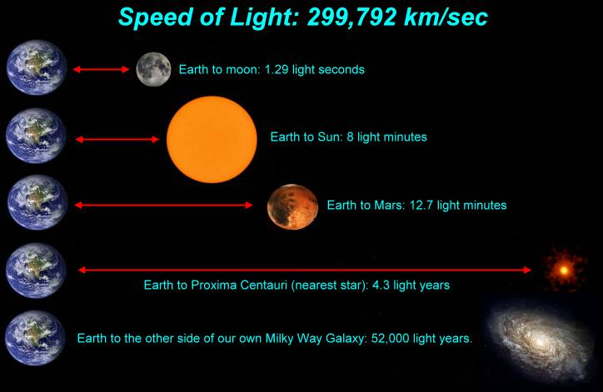
Daily Quiz: Tuesday – January 19, 2016 Today’s Objective: We will model and describe how light years are used to measure distances and sizes in the universe.
What do you think a light year is? (Infer from today’s objective)
How do you think this is useful for scientists studying the universe?
Closing Objective:
Compare and contrast a light year with an inch.

Slide 53
Daily Quiz: Wednesday – January 20, 2016 Today’s Objective: We will model and describe how light years are used to measure distances and sizes in the universe.
What is the speed of light?
What does a light year measure?
Closing Objective:
How far is the moon from the Earth?

Slide 54
Daily Quiz: Thursday – January 21, 2016 Today’s Objective: We will model and describe how light years are used to measure distances and sizes in the universe.
1. For Earth’s moon, the time between one full moon and the next full moon is approximately –
2. Proxima Centauri is a star that is 4.2 light years from Earth. Based solely on this information, what conclusion can be drawn?
Closing Objective:
A light year is a reasonable unit for measuring the size of what?
A | 28 days
B | 14 days
C | 1 week

Slide 55
Daily Quiz: Friday – January 22, 2016 Today’s Objective: We will model and describe how light years are used to measure distances and sizes in the universe.
1. What is the name of the moon phase that occurs when the moon is directly between the sun and the earth?
2. What is the name of the moon phase that occurs when the moon is on the opposite side of earth from the sun?
Closing Objective:
No closing objective.
Turn in your Daily quiz!

Slide 56
Oreo Lab
Directions:
Names of Lunar Phases
Google individual Moon Phases
Draw the Phase on the back of your Handout
Make it on the Oreo
Look at the cards for the order
Coach Wilson checks
Draw the Phases on your Handout (in order)
Eat Oreos!!
Waxing Gibbous
Waning Crescent
Full moon
First Quarter
Waxing Crescent
Third Quarter
Waning Gibbous
New Moon

Slide 57
Daily Quiz: Monday – January 25, 2016 Today’s Objective: We will model and describe how light years are used to measure distances and sizes in the universe.
1. What comes after a new moon?
2. What comes after a full moon?
Closing Objective:
How long does it take for the moon to orbit earth?

Slide 58
Daily Quiz: Tuesday – January 26, 2016 Today’s Objective: We will model and describe how light years are used to measure distances and sizes in the universe.
Cornell Note Questions
Insert Cornell Note line. Write questions next to drawings of moon phases. Complete from New Moon-Full Moon. You Have 5 Minutes.
Cornell Note Line to divide paper
Closing Objective:
Finish all questions for your notes.

Slide 59
Daily Quiz: Wednesday – January 27, 2016 Today’s Objective: We will model and describe how light years are used to measure distances and sizes in the universe.
1. What does waxing and waning mean?
2. What does crescent and gibbous mean?
Closing Objective:
Draw a waning gibbous moon.

Slide 60
Daily Quiz: Thursday – January 28, 2016 Today’s Objective: We will model and describe how light years are used to measure distances and sizes in the universe.
1. Which side is lit up if it is a waning gibbous moon?
2. Which side is lit up if it is a waxing crescent moon?
Closing Objective:
Draw a waxing crescent moon.

Slide 61
Daily Quiz: Thursday – January 28, 2016 Today’s Objective: We will model and describe how light years are used to measure distances and sizes in the universe.
1. Which side is lit up if it is a waning gibbous moon?
2. Which side is lit up if it is a waxing crescent moon?
Closing Objective:
Draw a waxing crescent moon.

Slide 62
Friday, January 29th Answers to the Test Review
B
C
D
C
B
C
D
D
C
A
C
We can only see portions of the lit part of the moon as the moon revolves around the Earth.
C
B
New – Sun, Moon, Earth Full – Sun, Earth, Moon
A
B
C
C
D
B

Slide 63
Daily Quiz: Monday – February 1, 2016 Today’s Objective: We will model and describe how light years are used to measure distances and sizes in the universe.
1. What confused you on your test?
2. List the moon phases in order.
Closing Objective:
Tell me one thing you know about ocean tides.

Slide 64
Daily Quiz: Tuesday – February 2, 2016 Today’s Objective: We will relate the position of the Moon and Sun to their effect on ocean tides.
1. Define gravitational pull.
2. Define lunar cycle.
Closing Objective:
What are 1st and last quarter moons?

Slide 65
Daily Quiz: Wednesday – February 3, 2016 Today’s Objective: We will relate the position of the Moon and Sun to their effect on ocean tides.
1. Define gravitational pull.
2. Define lunar cycle.
Closing Objective:
What are 1st and last quarter moons?

Slide 66
Daily Quiz: Thursday – February 4, 2016 Today’s Objective: We will relate the position of the Moon and Sun to their effect on ocean tides.
1. What is an ocean tide?
2. Differentiate between high and low tides.
Closing Objective:
What is a new moon and how will it effect the tides?

Slide 67
Daily Quiz: Friday – February 5, 2016 Today’s Objective: We will relate the position of the Moon and Sun to their effect on ocean tides.
1. Differentiate between spring and neap tides.
2. Describe the tidal effect.
Closing Objective:
How does the Earth’s revolution change the seasons?

Slide 68
Daily Quiz: Tuesday – February 16, 2016
How is thermal energy transferred in the formation and life cycle of a hurricane?
What role does the evaporation process from warm ocean surfaces play in the formation of storm clouds and hurricanes?
How does rapid evaporation of seawater affect the local air pressure and the formation of hurricanes?
What roles do the evaporation and condensation processes play in the formation of clouds and the development of storm systems?
Why do hurricanes form as low pressure air masses?
What processes determine the path that hurricanes follow?
How do ocean currents affect weather patterns on the continents?

Slide 69
Daily Quiz: Friday – February 18, 2016 Today’s Objective: The student is expected to identify how global patterns of atmospheric movement influence local weather using weather maps that show high and low pressures and fronts.
1. Pick up the yellow paper off of the front table.
2. You need a the yellow paper, a pencil/pen and your iPad. Put everything else away.
Closing Objective:
Discuss the stations you completed with a partner.

