Slide 1
Final Exam Review
Coach Wilson’s Class

Slide 2
Leeches are organisms that live in ponds. They feed on the blood of fish and other vertebrates and produce enzymes, which cause the animal on which it feeds to continue bleeding even after the leech is done feeding. This relationship would be classified as …

Slide 3
Freshwater parasite/host

Slide 4
Describe a predator/prey relationship in a freshwater environment.

Slide 5
Dragonflies capture and eat mosquito larvae in a river.

Slide 6
Describe a terrestrial parasite/host relationship.

Slide 7
Nematodes are tiny worms that feed on trees and cause disease in them.

Slide 8
One of the major effects the oceans have on our terrestrial environment here on Earth is:

Slide 9
Heat transfer within ocean water affects climates.

Slide 10
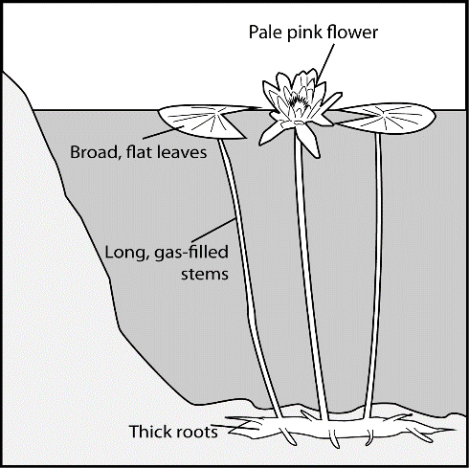
If annual rainfall increased and caused ponds in this habitat to become deeper, how, after many generations, might the traits of these water lilies change?

Slide 11
Longer stems

Slide 12
The Venus Fly Trap (Dionaea muscipula) is a plant, and like all other green plants, gets its energy from the Sun through photosynthesis. This plant, however, catches flies and breaks down their bodies using the chemicals to meet its needs. Which environmental condition led to this adaptation?

Slide 13
Soil with few nutrients

Slide 14
Chemicals used on crops to control insects affect ocean ecosystems when they –

Slide 15
Are washed into oceans, adding harmful substances.

Slide 16
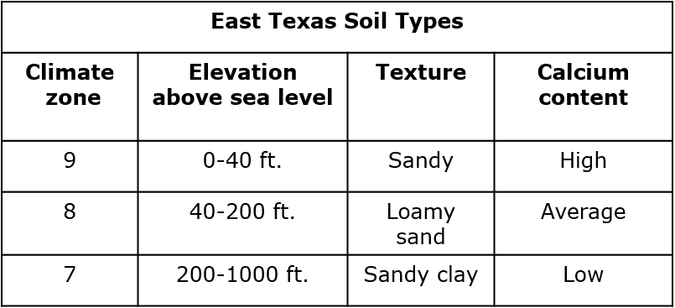
Which plants depend on and may compete for sandy soil in zone 9?

Slide 17
Black Hickory and Sweetgum

Slide 18
Which human activities will have a negative impact on the balance of organisms within an ocean ecosystem?

Slide 19
Commercial fishing to provide food for humans

Slide 20
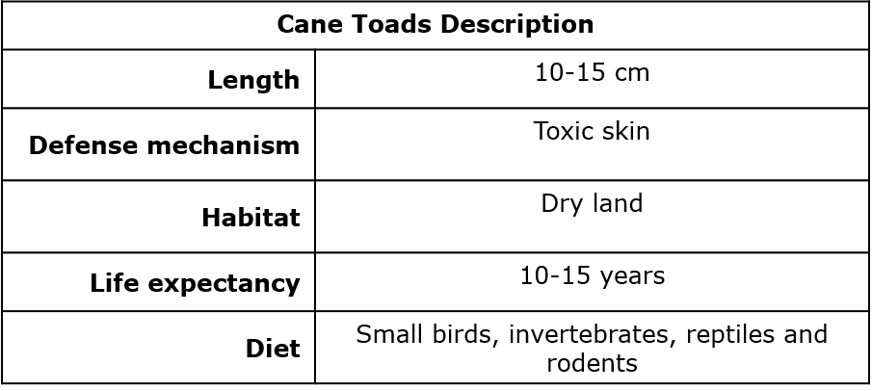
The aggressive South American cane toad was introduced to Australia by humans. Information about the cane toad is provided in the table. Based on the table, native organisms will be negatively affected by competition with cane toads if they –

Slide 21
Eat reptiles.

Slide 22
Even before modern observations provided evidence that supports the Theory of Plate Tectonics, people developed theories that the continents were once joined together. Using only maps, they observed that:

Slide 23
The shapes of continents appeared to allow them to fit together.

Slide 24
The border between two tectonic plates lies below the state of California. The interaction of these two plates results in

Slide 25
Earthquakes

Slide 26
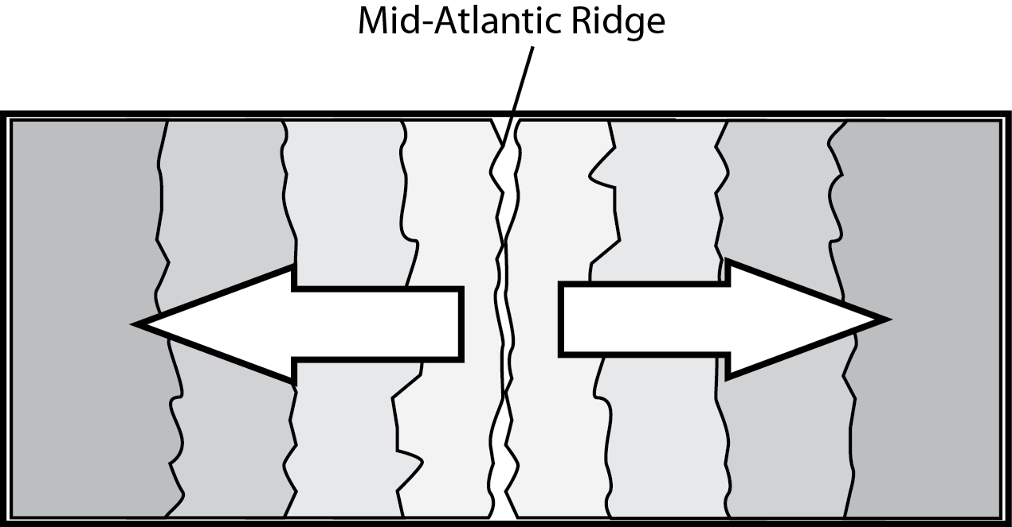
How did examining rocks that form on either side of the Mid-Atlantic Ridge provide evidence that supports the theory of Plate Tectonics?
Hint: As we look at rocks farther and farther from the ridge, the rocks…

Slide 27
Are consistently older.

Slide 28
The most recently formed crust on Earth would be found where?

Slide 29
Two plates are moving apart from each other.

Slide 30
Which land feature is likely to form where two tectonic plates push toward each other?

Slide 31
Mountain range

Slide 32
Stars are made mostly of which two elements?

Slide 33
Hydrogen and helium

Slide 34
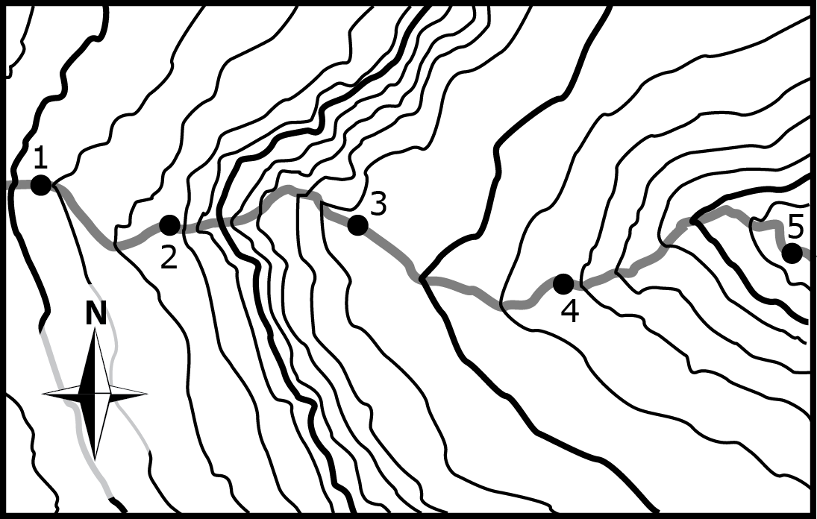
A river is running through the region represented by the topographic map shown here.
In which portion of the river will the water be flowing fastest?

Slide 35
Between Point 2 and Point 3

Slide 36
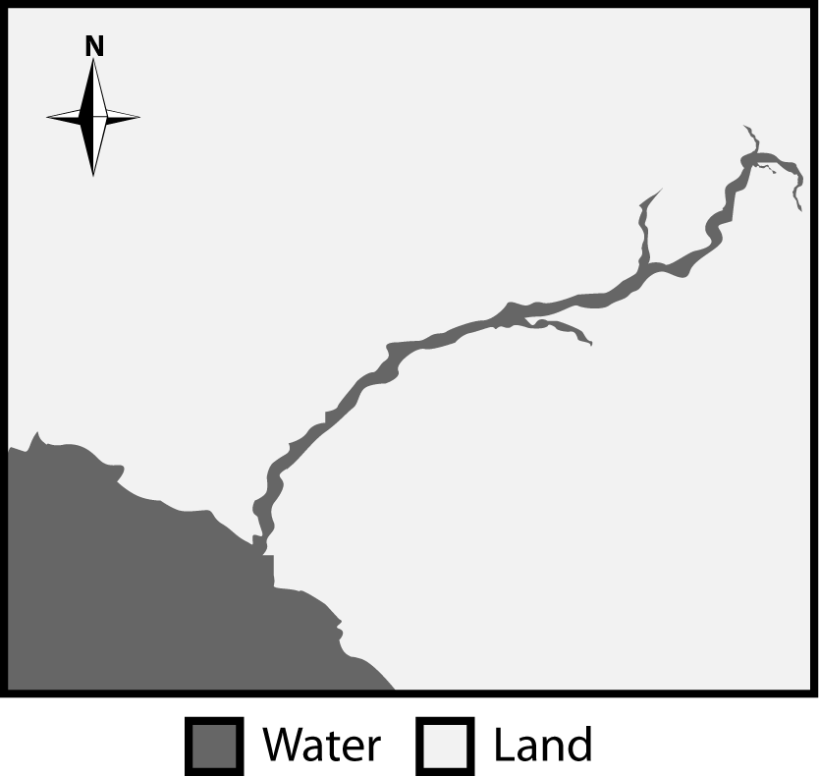
A picture of a satellite image with a river flowing over land is provided.
Which direction is the river is flowing?

Slide 37
Southwest.

Slide 38
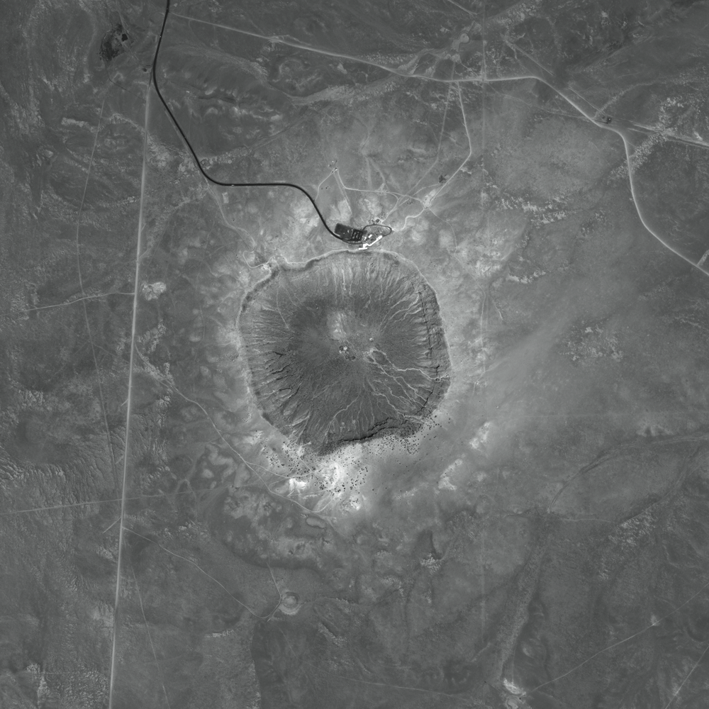
The satellite photograph below shows a large meteorite crater that is 1200 m in diameter and 170 m deep. This crater is located in a flat, arid part of northeastern Arizona.
How will this crater most likely change over time?

Slide 39
It will become less deep as the rim erodes.

Slide 40
Tides are the result of forces exerted on Earth’s oceans mostly by which celestial body?

Slide 41
The Moon

Slide 42
Describe the relative size of the Sun compared to other stars.

Slide 43
Medium-sized compared to all stars

Slide 44
A system of stars, gas, dust, and dark matter bound together by gravity is called –

Slide 45
A galaxy.

Slide 46
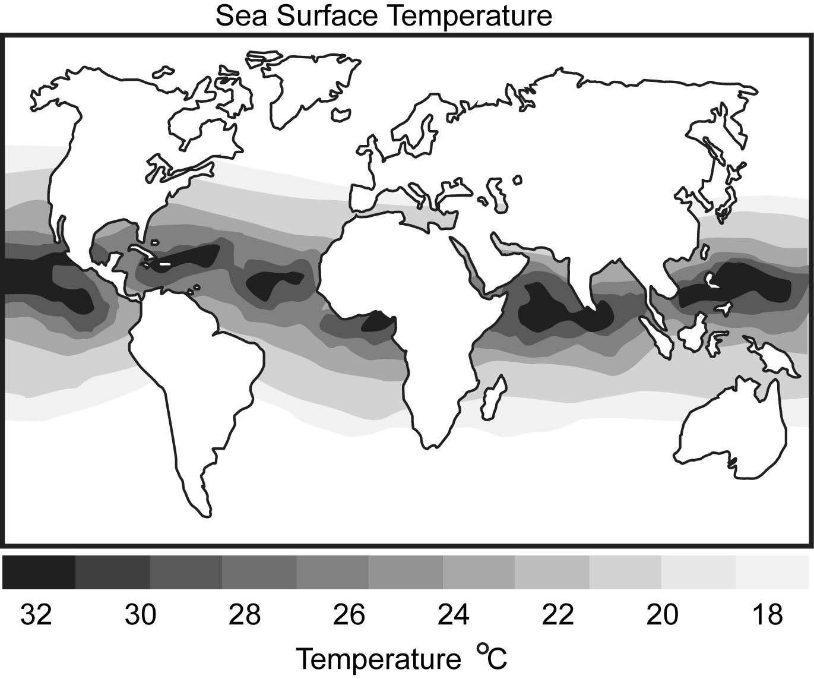
The patterns in thermal differences that generate ocean currents are explained by the fact that _____.

Slide 47
The Equator receives more of the Sun’s radiation than other parts of Earth.

Slide 48
Which lunar phase will occur approximately 7 days after a first quarter moon?

Slide 49
Full moon

Slide 50
The sun is classified as which type of star on the H-R Diagram?

Slide 51
Main Sequence

Slide 52
What causes Earth to have day and night?

Slide 53
Earth’s rotation on its axis

Slide 54
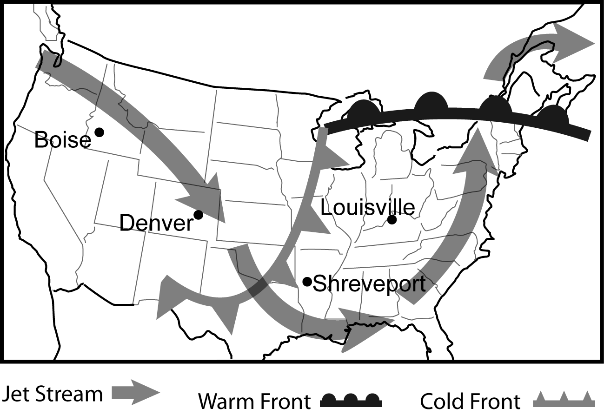
Based on the information provided in the weather map, which city shown most recently saw a rise in temperature?

Slide 55
Louisville

Slide 56
Using the diagram of the Electromagnetic Spectrum, which portion of wave patterns would best illustrate the visible light wave pattern that we see?

Slide 58
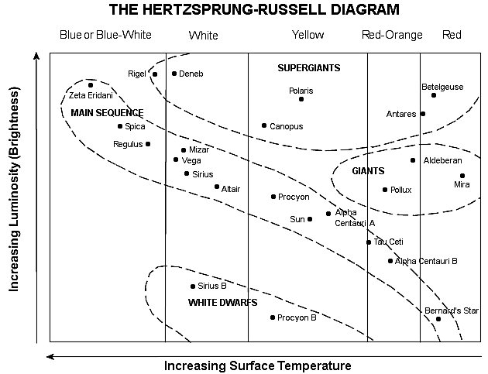
In the Herztsprung-Russell diagram above, we see a group of stars in the Main Sequence. What is the relationship between a star’s temperature and luminosity (brightness)?

Slide 59
As the temperature increases, the luminosity increases.

Slide 60
Describe the action the students must perform to demonstrate what causes the changing appearance of the Moon from Earth.

Slide 61
Moving the tennis ball around the basketball.

Slide 62
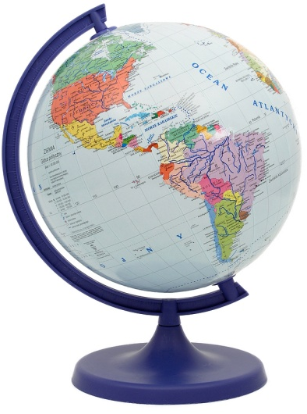
A student is using a globe to model the seasons. If the northern hemisphere is tilted towards the Sun, what season is occurring in Texas?

Slide 63
Summer

Slide 64
Proxima Centauri is the closest star to Earth after the Sun and is located 4.3 light years away from Earth. How long does it take light from Proxima Centauri to reach Earth?

Slide 65
4.3 years

Slide 66
Why does the Moon have a greater effect on ocean tides than the Sun?

Slide 67
The Moon has a greater gravitational pull on Earth’s oceans because it is much closer.

Slide 68
Describe the position of the Sun relative to other objects in space?

Slide 69
On the edge of the Milky Way Galaxy

Slide 70
One piece of evidence that supports the Theory of Plate Tectonics is the discovery of what in both South America and Africa?

Slide 71
Fossil remains of the same land-dwelling animal were found on each continent.

Slide 72
A hiker planning a trip up a mountainside might want to select the face of the mountain which provides the easiest hike. When looking at a topographic map, what would indicate the part of the mountain that would provide the easiest path for the hiker to take?

Slide 73
Contour lines spaced far apart

Slide 74
If the greatest erosion on a mountain will occur where the slope is the steepest, one could locate this portion of a mountain on a topographic map by looking for the area where the topographic lines –

Slide 75
Are closest together

Slide 76
Identify the major source of energy that creates hurricanes.

Slide 77
Sun’s radiation

Slide 78
Fleas consume the blood of mammals for their food source. Often the bite of a flea can cause illness. This relationship would be classified as _____.

Slide 79
Terrestrial parasite/host

Slide 80
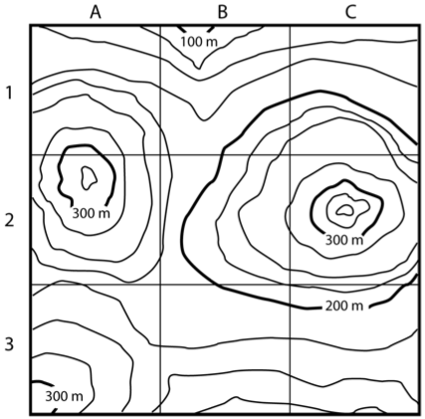
The highest peak represented by the topographic map can be found in which quadrant?

Slide 81
C2

Slide 82
Describe a parasite/host relationship in a marine environment.

Slide 83
Copepods feed on the eyes of sharks, blinding them.

Slide 84
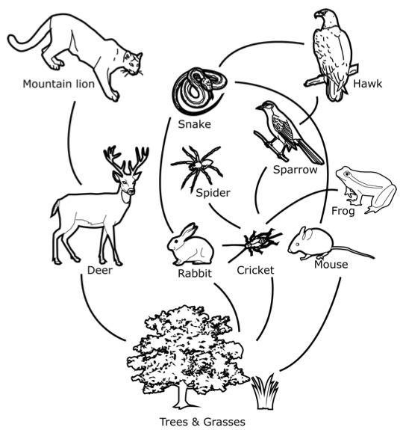
The terrestrial food web is provided. Which pair of organisms represents a producer/consumer relationship?

Slide 85
Mouse & grass

Slide 86
A nucleotide consists of a nitrogenous base, along with –

Slide 87
A sugar and phosphate.

Slide 88
List the nitrogenous base pairings.

Slide 89
Cytosine/guanine
Adenine/Thymine

Slide 90
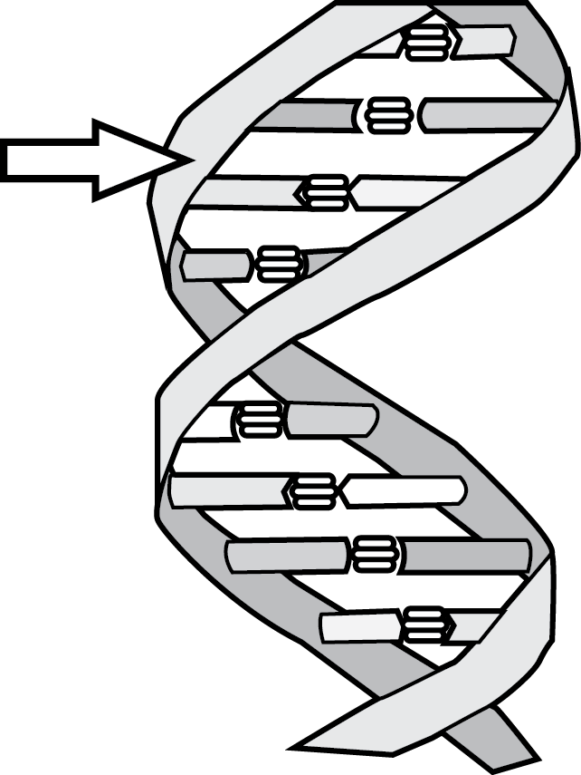
A diagram of the DNA double helix is provided.
Which component of DNA is indicated by the arrow?

Slide 91
Sugar-phosphate backbone

Slide 92
All living things have _____ which supports the idea that the genetic code is common to all living things.

Slide 93
Genes using the same nitrogenous bases.

Slide 94
A similarity between proteins, carbohydrates, lipids, and nucleic acids is that they all –

Slide 95
Contain the element carbon.

Slide 96
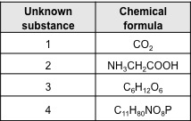
Which unknown substance represents a carbohydrate in the data table shown?

Slide 97
3

Slide 98
Which biomolecule is the major energy source for cells?

Slide 99
Carbohydrates

Slide 100
Which biomolecule is composed of three basic elements: carbon; hydrogen; and oxygen, and can be found in the form of unsaturated or saturated fats?

Slide 101
Lipids

