Slide 1
Your Muscular System

Slide 2
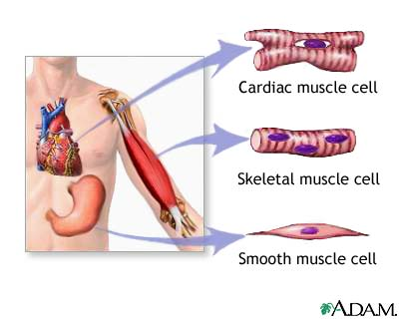
Types of Muscles
Your body has three types of muscle tissue—skeletal muscle, smooth muscle, and cardiac muscle.

Slide 3
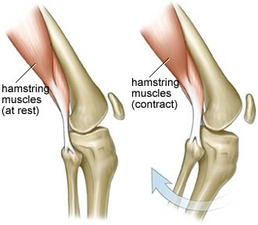
Skeletal Muscle
Skeletal muscles are attached to the bones of your skeleton. Because you have conscious control of skeletal muscles, they are classified as voluntary muscles. These muscles provide the force that moves your bones. Skeletal muscles react quickly and tire quickly. At the end of a skeletal muscle is a tendon. A tendon is a strong connective tissue that attaches muscle to bone. Note- ligaments connect bones together.

Slide 4
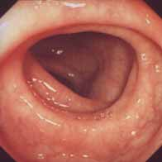
Smooth Muscle
Smooth muscles are called involuntary muscles because they work without your conscious effort.

Slide 5
Cardiac Muscle
Cardiac muscles are involuntary muscles found only in the heart. Cardiac muscles do not get tired.
A Cardiac Muscle Cell

Slide 6
Voluntary Muscles
The muscles that are under your direct control are called voluntary muscles. Smiling and turning the pages in a book are actions of voluntary muscles

Slide 7
Involuntary Muscle Action
The muscles that are not under your conscious control are called involuntary muscles. Your colon (left) is lined with smooth muscle, and your heart (right) is comprised of cardiac muscle which works automatically pumping blood around your body.

Slide 8
How Do Muscles Work?
Muscles work by contracting, or becoming shorter and thicker. Because muscle cells can only contract, not extend, skeletal muscles must work in pairs. While one muscle contracts, the other muscle in the pair returns to its original length. For example, in order to move the lower arm, the biceps muscle on the front of the upper arm contracts to bend the elbow. This lifts the forearm and hand. As the biceps contracts, the triceps on the back of the upper arm returns to its original length. To straighten the elbow, the triceps muscle contracts while the biceps returns to its original length.

Slide 9
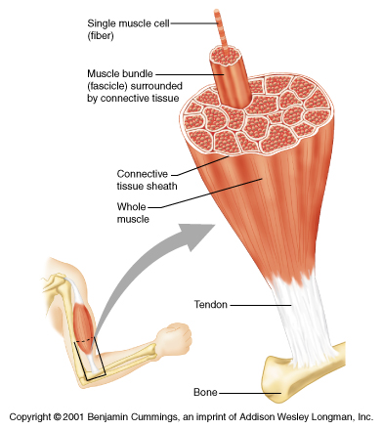
Anatomy Of A Muscle

Slide 10
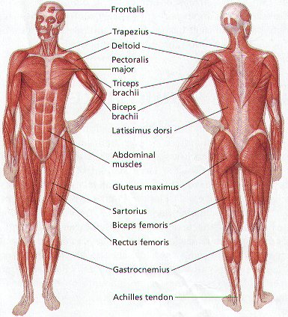
Can You Name the Major Muscles of your Body. Try It!

Slide 11
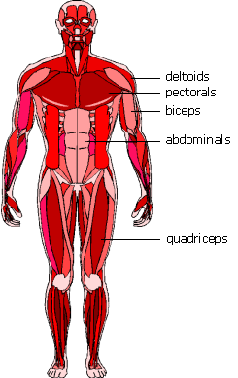
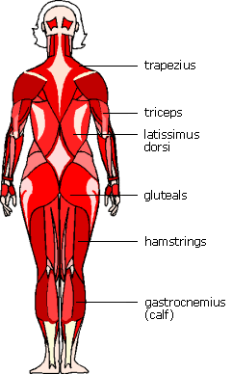
Some Major Voluntary Muscles

