Slide 1
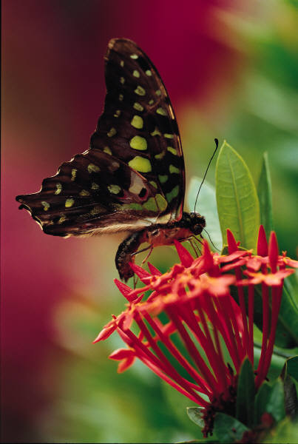
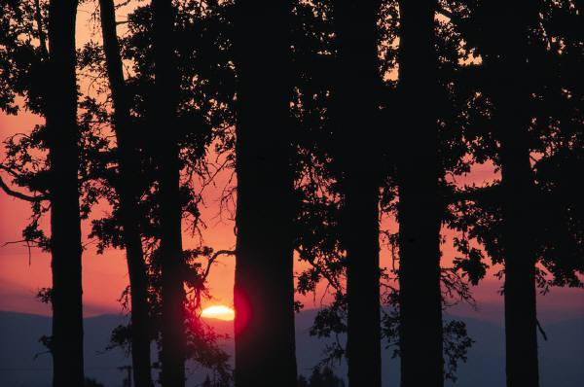
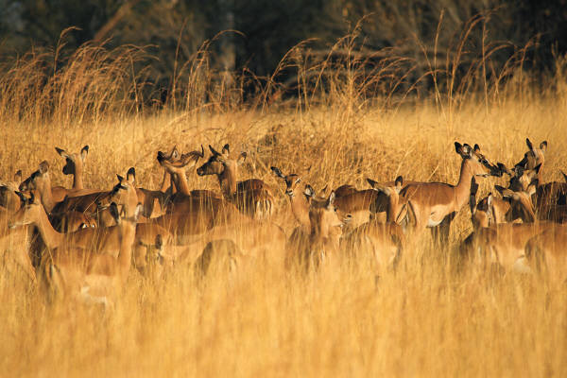
What is an ecosystem?
The field of ecology includes plants, animals, sunlight, soil and other things.
Living and nonliving things that interact in a particular area

Slide 2
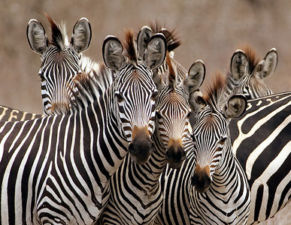
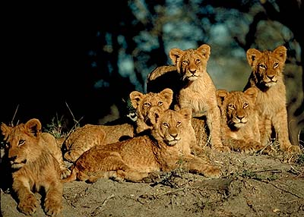
POPULATION
a group of organisms of one species living in the same place at the same time that interbreed
Produce fertile offspring
Compete with each other for resources (food, mates, shelter, etc.)
Notes:
The next level is a population. A population consists of a single species living together and breeding. Give me an example of a population. Ex. large mouth bass living in Lake Meade. Beetles living under the same log. Here we have salmon spwning and two bears fishing.

Slide 3
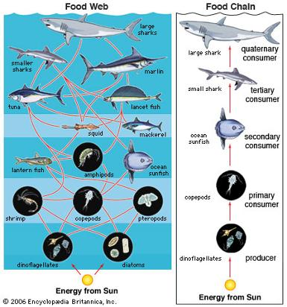
Community - several interacting populations that inhabit a common environment and are interdependent.
Notes:
Next level is a community which is several populations living together and depending on each other. What does interdependent mean? An example of a community is shown here with the bear and the salmon. They both live in a common environment and the bear needs the fish for food? How does the salmon need the bear?

Slide 4
External factors affecting environment
  Biotic factors are anything related to living organisms that impact another organism
  Competition for resources
  ex: field mouse competing with another animal for food
  Predator-prey relationships
  ex: hawk hunting a mouse

Slide 5

INTERACTIONS AMONG ORGANISMS
Predator-prey
An animal that hunts or kills other animals for food is called a predator.
An animal that is eaten by another is called prey.
Give an example of a predator-prey relationship.

Slide 6
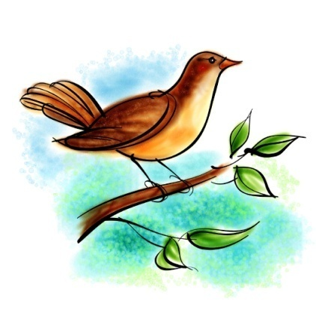
Can you match some predator-prey relationships?

Slide 7

Predator Prey

Slide 8
External factors affecting environment
  Abiotic factors are the nonliving parts that affect its survival and growth
  Sunlight, temperature, shelter, water supply
  Temperature influences the most
  Ex: if a plant cannot tolerate frost then it is less likely to survive

Slide 9
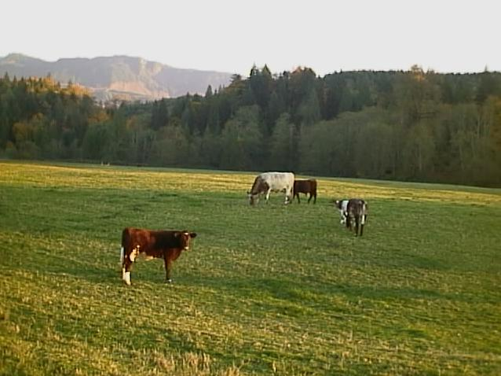
What are the biotic and abiotic factors in this picture? Create a T chart and list them
http://www.thegardenhelper.com/102902.JPG

Slide 10
biotic
abiotic
Cows
Grass
Trees
Shrubs
Others unseen
Air
Water
Soil, rocks
Light
Temperature

Slide 11
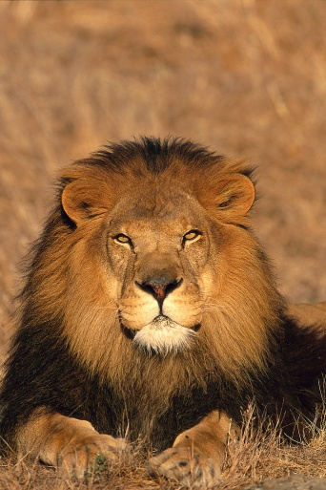
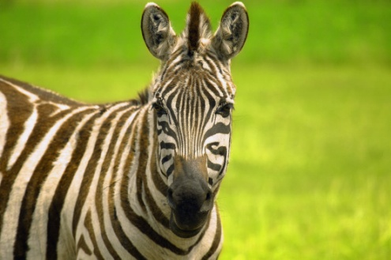
niche
function of an organism in an ecosystem
role of an organism in the community
how it satisfies its need for food and protection
Zebras and lions have the same habitat, the grasslands of Africa. A zebra eats grass and a lion eats meat. Thus, they have different niches.

Slide 12
competition
The number of niches in an ecosystem is limited. In a certain area, two populations may try to occupy the same niche.
Then they compete with one another.
The one that is better adapted for the niche will win and will crowd out the other population.
In a stable community, two organisms cannot occupy the same niche. Why do you think this is?

Slide 13
Do the lion and zebra need to compete to be a stable community? Can you think of another organism that might compete in this ecosystem?

Slide 14
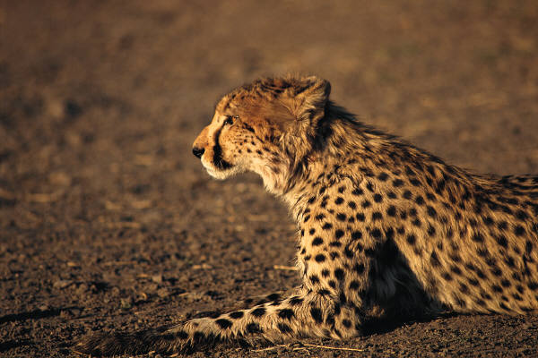
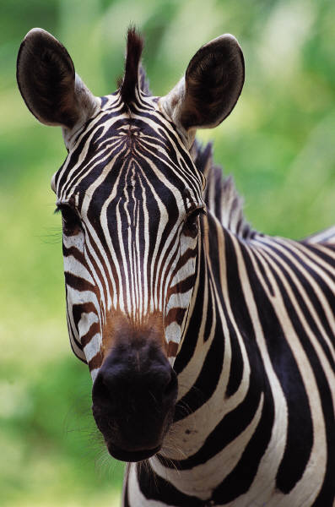
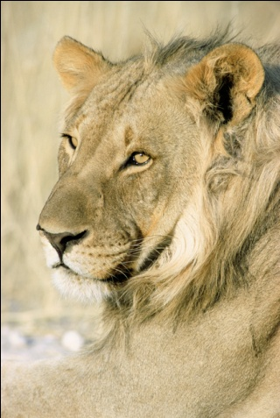
Suppose in an ecosystem with finite resources the cheetah and lion were competing for the same resource, the zebra. What might happen in this situation to the zebra population?
Oh dear

Slide 15

This can lead to population declines
Population reduction means fewer food resources for all the lions and cheetahs which leads to a decline in the predator populations.
If the two can share the resources the ecosystem can remain stable and the two can coexist.

Slide 16
If one plant can grow taller (an oak tree) than a shorter plant (a flower), what might these two plants compete for?
Which plant do you think would survive in this case? Why?

Slide 17


If the oak plant can grow taller than the flower then it can get the resource it needs (light) while shorter plants cannot.

Slide 18
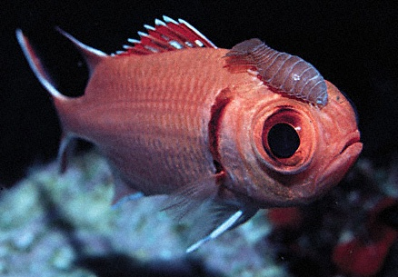
Symbiotic Relationships
Symbiosis- two species living together
3 Types of symbiosis:
1. Commensalism
2. Parasitism
3. Mutualism
Notes:
Cleaning shrimp

Slide 19
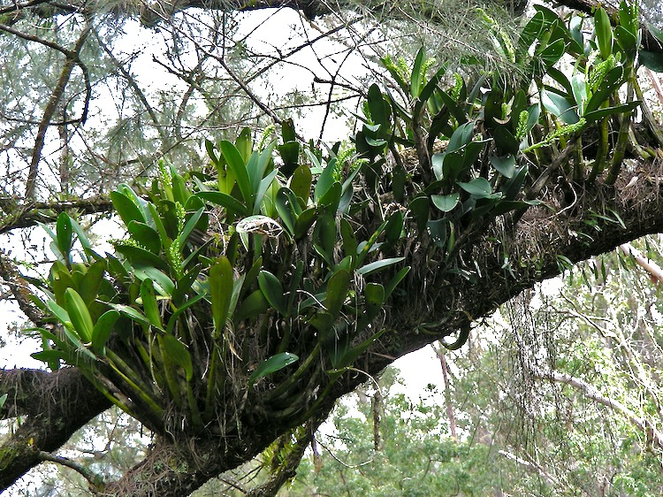
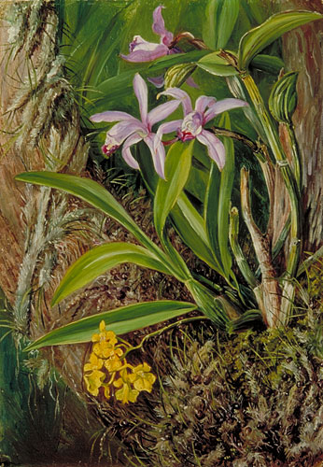
Symbiotic Relationships
Commensalism-
one species benefits and the other is neither harmed nor helped
Ex. orchids on a tree
Epiphytes: A plant, such as a tropical orchid or a bromeliad, that grows on another plant upon which it depends for mechanical support but not for nutrients. Also called xerophyte, air plant.

Slide 20
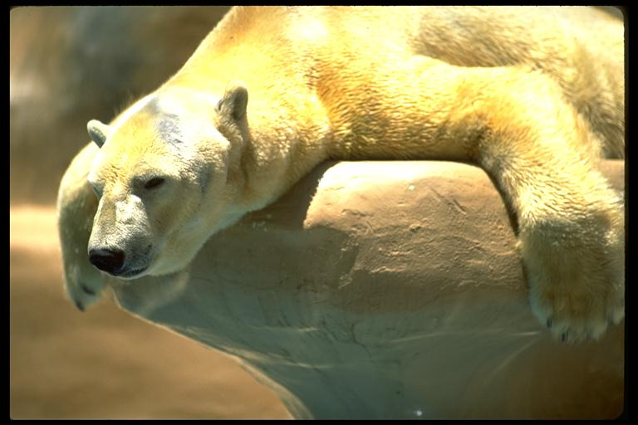
Symbiotic Relationships
Commensalism-
one species benefits and the other is neither harmed nor helped
Ex. polar bears and cyanobacteria
Notes:
You can see here that this polar bear is no longer white.

Slide 21
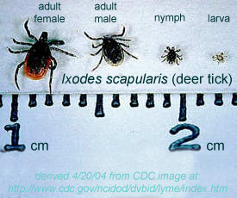
Symbiotic Relationships
Parasitism: one species benefits (parasite) and the other is harmed (host)
Parasite-Host relationship

Slide 22
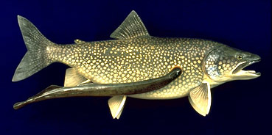
Symbiotic Relationships
Parasitism- parasite-host
Ex. lampreys,
leeches, fleas,
ticks, tapeworm

Slide 23
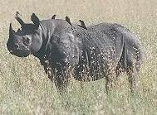
Symbiotic Relationships
Mutualism:
beneficial to both species
Ex.: cleaning birds and cleaner shrimp
Notes:
The Egyptian plover takes insects from the backs of buffaloes, giraffes and rhinos. The plover has also been observed taking leeches from the open mouths of crocodiles! In this association the plover receives a supply of food and the other animal rids itself of unwelcome pests

Slide 24
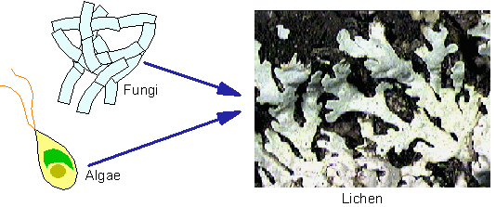
Symbiotic Relationships
Mutualism: beneficial to both species
Ex. lichen
Notes:
The Egyptian plover takes insects from the backs of buffaloes, giraffes and rhinos. The plover has also been observed taking leeches from the open mouths of crocodiles! In this association the plover receives a supply of food and the other animal rids itself of unwelcome pests

Slide 25
Type of relationship | Species harmed | Species benefits | Species neutral
Commensalism
Parasitism
Mutualism
= 1 species

