Slide 1
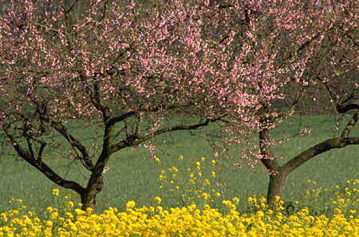

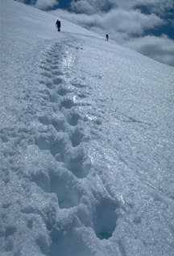


Why do we have days, nights, and seasons?

Slide 2
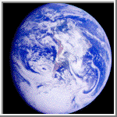
To understand why we have seasons here on earth we must first look out from space.

Slide 3

Because the earth is spinning, different parts of the earth are reflecting light from the sun.
Areas that are being hit by the sun are experiencing daylight. Areas that are blocked from the suns rays are experiencing night. One rotation (or spin) takes 24 hours, or one day.
Day and Night

Slide 4
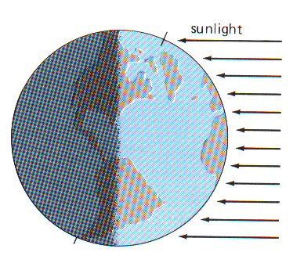
Light from the sun is the main source of heat for the whole planet.
However, it does not heat the whole planet equally.
The area in the middle is getting the most direct light.

Slide 5
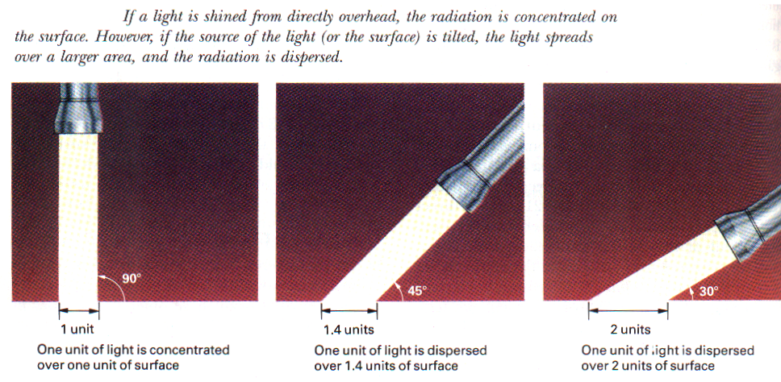

Slide 6


However, the earth is not spinning in line with the sun.
It is on a tilt.
Its axis is always pointed toward the North Star, also called, Polaris

Slide 7
As the Earth travels around the Sun, different areas of the earth are hit directly with the sun’s rays.

Slide 8
Click to make the earth move. What season are we in at each stage? (Question 4)
Stage 1- Summer
Stage 2- Fall
Stage 3- Winter
Stage 4- Spring
Click for answers

Slide 9
In the summer, the northern hemisphere is hit more directly by the sun so it is warmer in the North.
You are here

Slide 10
In the winter, the southern hemisphere is hit more directly by the sun. So it is colder in the North.
You are here

Slide 11
Effects of direct and indirect sunlight:
In the summer it is warmer in the Northern Hemisphere; the days are longer; the Arctic (North Pole) will have six months of daytime.
In the winter it is colder in the Northern Hemisphere; the days are shorter; Antarctica (South Pole) will have six months of daytime.

